Slide 1
DAY 16 PPT
SINGLETON ADT, SECURED PROGRAMMING

Slide 2
Singleton ADT
A Singleton is a design pattern that restricts the instantiation of a class to only one instance and provides a global point of access to that instance. It ensures that a class has only one instance and provides a way to access that instance from any part of the application.
Here's a breakdown of the Singleton pattern:
Single Instance: The Singleton pattern ensures that there is only one instance of the class throughout the entire application's lifecycle. This is achieved by providing a mechanism to prevent multiple instantiations of the class.
Global Access: The Singleton instance is typically accessible globally within the application. Any part of the code can access the Singleton instance without needing to instantiate the class explicitly.
Lazy Initialization: The Singleton instance is created only when it is first requested. This is known as lazy initialization and helps conserve system resources by avoiding unnecessary instantiation of the Singleton until it is actually needed.
Thread Safety: In multi-threaded environments, it's essential to ensure that the Singleton instantiation process is thread-safe to prevent race conditions and ensure that only one instance is created even in concurrent scenarios.
Private Constructor: To prevent external instantiation of the class, the Singleton class usually has a private constructor, which means that it cannot be instantiated directly from outside the class.
Static Instance Method: The Singleton class provides a static method that allows clients to access the Singleton instance. This method is typically named something like getInstance().
Lifetime Management: The Singleton instance typically remains alive for the duration of the application's lifecycle. It is usually created when it is first requested and destroyed when the application terminates.

Slide 3
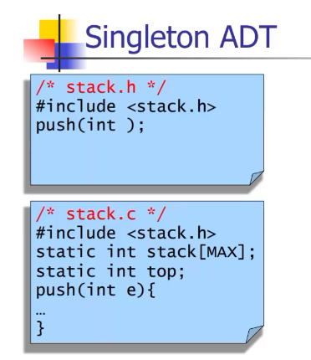
Singleton ADT EXAMPLE

Slide 4
SECURED PROGRAMMINF
Secure programming refers to the practice of writing software in a way that mitigates security risks and vulnerabilities. It involves following coding practices, principles, and guidelines to build systems that are resistant to attacks, maintain data integrity, and protect against unauthorized access.
Here are some key principles and practices of secure programming:
Input Validation: Validate and sanitize all user inputs to prevent injection attacks, buffer overflows, and other forms of input-based vulnerabilities.
Output Encoding: Properly encode output data to prevent injection attacks, such as HTML, SQL, or JavaScript injection. Use secure output functions or frameworks that automatically handle encoding.
Authentication and Authorization: Implement robust authentication mechanisms to verify the identity of users and ensure that only authorized users have access to sensitive resources or functionality.
Data Protection: Use encryption and hashing techniques to protect sensitive data both in transit and at rest. Implement secure storage and transmission protocols to safeguard user credentials, personal information, and other confidential data.
Error Handling: Implement appropriate error-handling mechanisms to provide informative error messages without revealing sensitive information that could be exploited by attackers.
Secure Configuration: Configure software and systems securely, following best practices and security guidelines. Apply security updates and patches promptly, and disable unnecessary services or features that could be exploited.
Secure Communication: Use secure communication protocols (e.g., HTTPS) to encrypt data transmitted over networks and ensure that connections are authenticated and protected against eavesdropping or tampering.
Least Privilege: Follow the principle of least privilege, granting users, processes, or systems only the minimum level of access or permissions necessary to perform their intended tasks. Limit access to sensitive resources and functionality to authorized entities only.

Slide 5
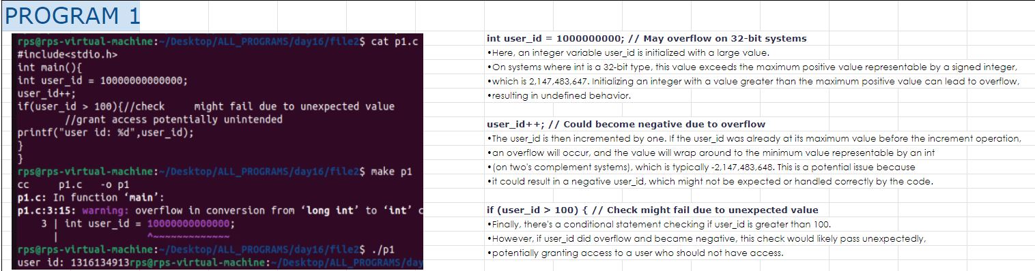
Unsecured Programs Example

Slide 6
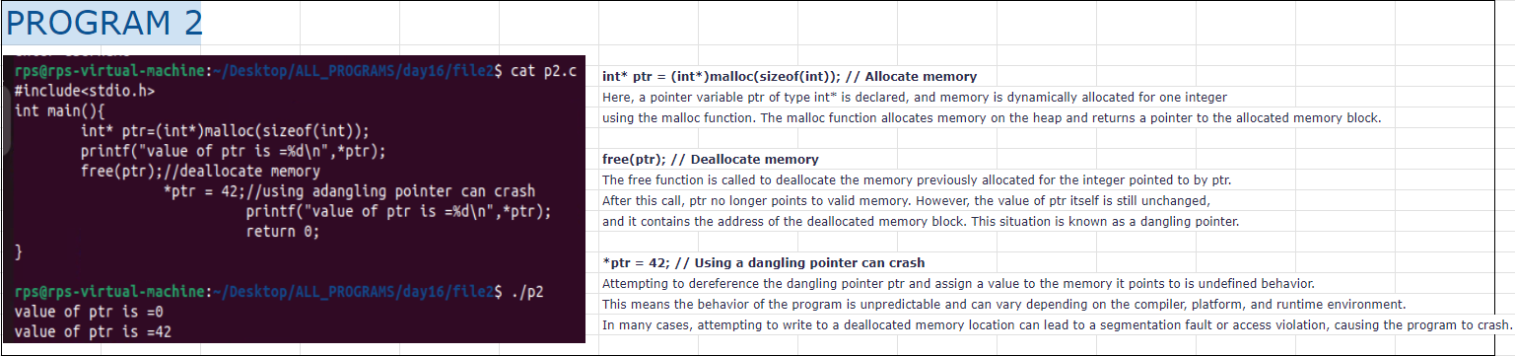
Unsecured Programs Example

